Slide 1
Financial Management Financing the Business, Risk & Leverage, & Risk & Return
2018 January ELEC/CPEN 481
Lecture 9

Slide 2
content
Capitalization: Financing Overview & Options
Debt
Equity
Other Financing Options: Capital lease, Trade Credit, Crowd Funding, Factoring
5Cs
Risk & Leverage Analysis
Business Risk
Financial Risk
Risk & Return Trade Off

Slide 3
Capitalization: Financing Overview & Options

Slide 4
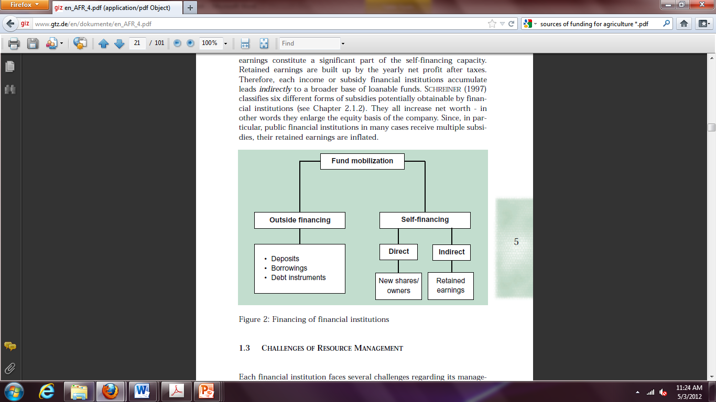
What is capitalization?
Term used to describe how a firm’s assets are financed .
Equity Internal: Retained Earnings - Financial progress
Equity External: Investment of the owner(s) of a company or other sources – New $
Debt: Financing that a business owner has borrowed and must repay with interest
DEBT (outside)
EQUITY (inside)

Slide 5
Debt Financing

Slide 6
Debt Financing Overview
Debt Options( also called loans or liabilities)
Short Term – less than one year
Long Term – more than one year
Challenge - determining what type of debt financing to pursue, based on business type, stage of business, personal finances, capital requirements, preferences, and the options available to you.
Different types of lenders offer various rates and fees, need to compare the total package costs.
Use Financial Statement and Ratios to assess

Slide 7
Debt Financing - Short Term Loan
Use:
Finance day-to-day operations not to purchase CAPITAL ASSETS
Examples:
Operating Loans, Revolving Lines of Credit, Visa & Master Card, Production Loan, Overdraft
Characteristics:
Shows up as a current liability in balance sheet
Collateral not required so generally higher interest rate
Repaying a short term debt consists of
Paying debt off to a zero balance in a time frame defined by the bank
Interest charge (an expense as it accumulates over time) usually paid monthly

Slide 8
Debt Financing - Long Term Loan
Debt Instrument – borrowed money
Use:
Purchase CAPITAL ASSETS - used to generate goods/services
Sources
Examples:
chattel loan, mortgage
Characteristics
Collateral required
Term of loan related to the useful life of the asset(s)
Repayment
Both interest and principal pmts required during the repayment period.Terms agreed upon with bank – length, rate, payment timing
Interest is tax deductible for the corporation paying it
Interest rate increases as term of loan increases

Slide 9
Debt Financing - Long Term Loan
Parts of a Typical Loan Agreement
Note: Specifies the principal and the interest and the timing of repayment.
Collateral: Specifies assets assigned and terms under which lender takes possession of assets.
Covenants: Specifies actions that the borrower must take. Maintaining liquidity and equity as measured by financial ratios, maintaining insurance, file financial reports, pay taxes, etc.
Borrower Guarantees: Who is liable and for what? Related to legal structures
Events of Default: Exact conditions under which a loan is considered in default.

Slide 10
Debt Financing - Bond
Bond is a type of debt instrument (borrowed money)
way for a company or government to raise money by selling, in effect, IOUs – with annual interest payments.
Sources Buy bonds direct from corporation or secondary public market
Use
Repayment
Repay the principal amount (face value) when the bond matures – e.g. 5, 10, 20 or 30 years.
Interest at a defined rate provided by issuer at set intervals (coupons) over the bond's life (term) - tax deductible for the corporation paying it
Security – depends but not usually (assess credit worthiness)
Owner can Transfer - A bond can be bought and sold on the secondary market, subject to there being sufficient liquidity in the market. The value or price of a bond may fluctuate due to a number of factors such as interest rate movements and the perceived credit worthiness of the issuer.

Slide 11
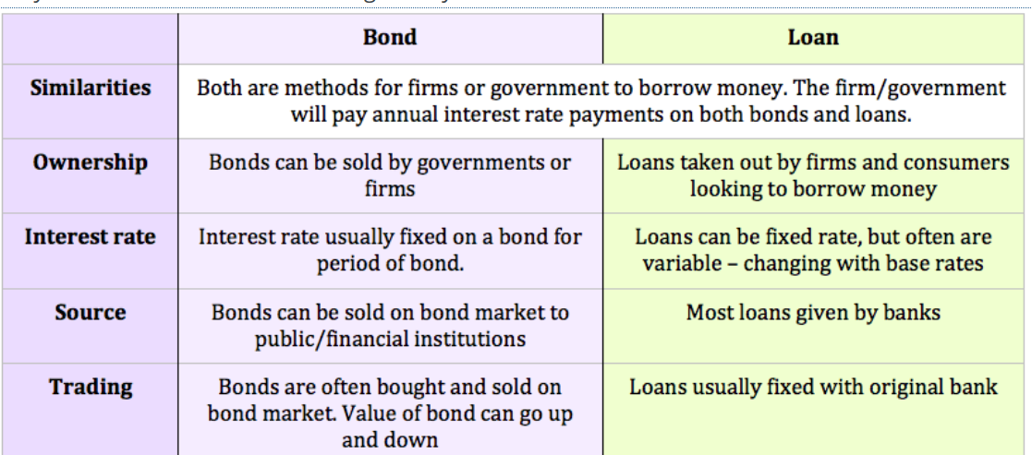
Debt Financing – Bond vs Loans

Slide 12
Debt Financing:
Debt Advantages
Use of Debt magnifies return on equity
The lender has no say in the management or direction of the business, as long as the loan payments are made and contracts are not violated.
Debt payments are predictable; they do not change with the fortunes of the business.
Debt payments can be set up so that they are matched with the seasonal sales of the business.
Lenders do not share in the business’s profits.

Slide 13
Debt Financing:
Debt Disadvantages
Financial Risk and Liability Concerns – fixed debt payment required
Use of debt magnifies financial risk and potential losses
Lenders expect regular financial reporting and compliance with the loan contracts.

Slide 14
Equity Financing

Slide 15
Equity Financing
Provide money and in return, receive share/stocks that represent ownership (%) of business
Repayment
Equity owners get profit from a company (dividend) but DO NOT get their original investment back
Use ?
Collateral
Normally - no collateral required - unsecured as it reflects the faith of the investor in the business
Major considerations because this frees up assets to be used as security for the loans (debt financing).

Slide 16
Equity Financing
Sources:
Venture capital companies
Owner investment via personal savings or asset contributions
Friends and family members
Angel Investors
Partners
Corporate venture capital
Public stock sale (IPO)

Slide 17
Equity Financing: Pros and Cons
Equity Advantages
Some flexibility in pmts:
business does not make a profit, the investor does not get paid.
dividends for common stockholders are distributed at the discretion of the board of directors.
Equity investor cannot force the business into bankruptcy in order to recoup the investment.
Equity investor has an interest in seeing the business succeed and may, therefore, offer helpful advice and provide valuable contacts.

Slide 18
Equity Financing: Pros and Cons
Equity Disadvantages
Giving up ownership, the original owner could lose control of the business to the equity holders.
Equity financing is riskier for the investor, UNSECURED, so usually expect higher return to compensate
No financial risk but then no leverage effect

Slide 19
Other Types of Financing

Slide 20
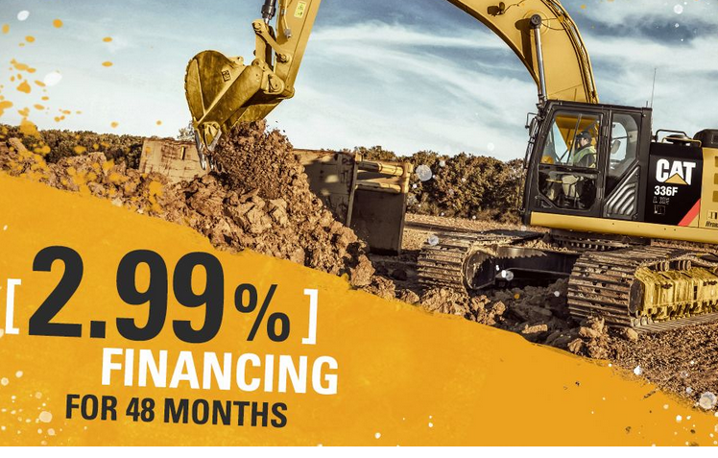

Capital Leases
'Capital Lease‘
On an accounting basis:
capital leases supplier of the good or equipment provides the financing
Supplier credit to support a sale

Slide 21

Trade Credit /Account Payable
Financing suppliers extend by allowing customers to pay for goods or services sometime after delivery
Common type called open account: where the seller accepts the account and fills the buyer’s order and sends out an invoice
Can be terms of
cash before delivery (CBD)
cash on delivery (COD)

Slide 22
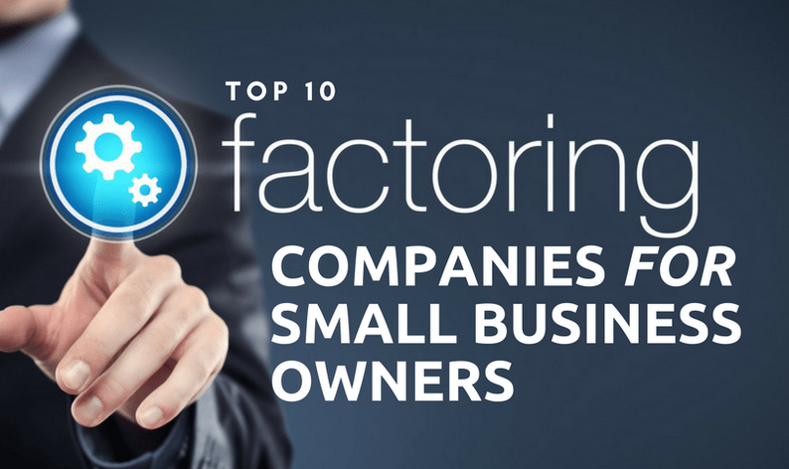
Factoring
Purchase of A/R at a discount
taking over credit screening and collections
assuming the risk of bad debt
financing by advancing funds that would otherwise be collected later
Credits cash and quickly!

Slide 23
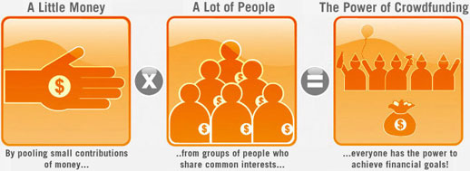
Crowd funding
Funding of a company by pooling contributions of small amounts by many investors

Slide 24

Crowd funding?
Crowd funding.. Funding of a company by selling small amounts of equity to many investors
http://www.youtube.com/watch?v=8b5-iEnW70k

Slide 25
Comparison of Debt, Equity, Crowdfunding
Basis for Comparison
Obligations & /or Payments
Control & Decision Making
Collateral
Profit Sharing
Financial Leverage (more on this later)
Uses & Amounts
Tax Implications

Slide 26
Consideration of Owners, Bankers & Investors when Providing Financing

Slide 27
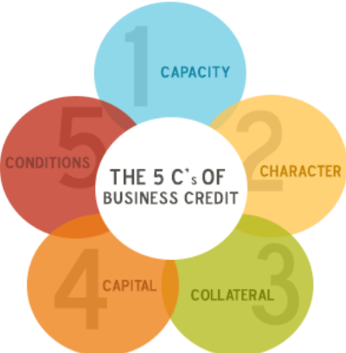
Consideration of Owners, Bankers & Investors when Providing Financing
5Cs of Credit
Consider how each of these are assessed?
Balance between the Cs is key!! Less of one means you will need more of another!

Slide 28


EXAMPLE: 5 Cs
Versus

Slide 29
Consideration of Owners, Bankers & Investors when Providing Financing
5Cs of Credit
Character
Capital
Collateral
Conditions
Capacity

Slide 30
Risk & Leverage Analysis

Slide 31
Business Risk
What is business risk?
Results from general economic cycles, changing industry conditions:
Creates Price and Production variations & thus variability of profit from one year to the next
Inherent uncertainty faced by the business independent of the way the business is financed
Exists in all businesses and cannot be eliminated – can be mitigated using strategies
Concern especially for those firms that have lots of debt

Slide 32

examples

Slide 33
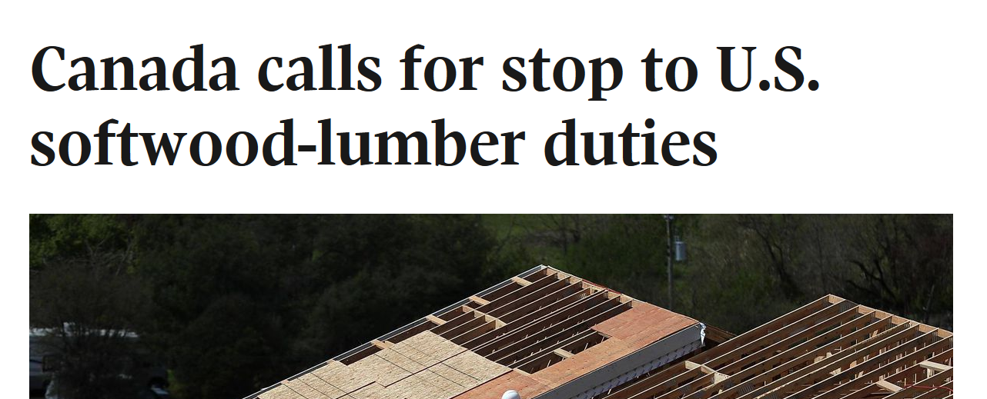
examples

Slide 34
Business Risk Assessment
How is business risk assessed?
Assessment Methods
Breakeven Analysis
Degree of Operating Leverage

Slide 35
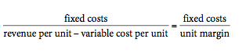
Business Risk Assessment
Breakeven Analysis
Review of relationships among revenue, fixed costs, and variable costs
Based upon the
Profit Equation Profit = total revenue - total cost
Profit = [P X Q] – {[VC * Q] + FC}
Where P = price Q = quantity FC = fixed cost VC = variable cost/unit
Reorganize variables and obtain
B/E Quantity=

Slide 36
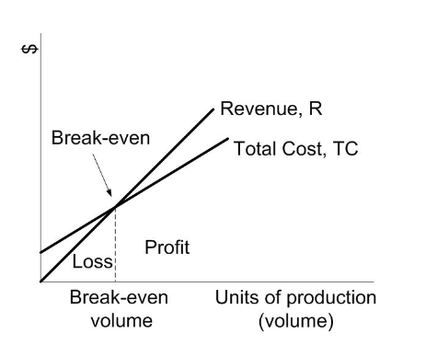
Business Risk Assessment
Breakeven
When variable cost, is lowered, Q_{BE} decreases (moves to left)

Slide 37
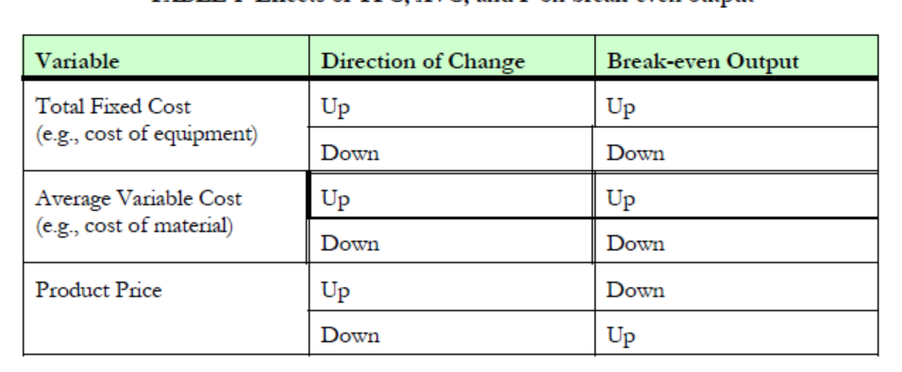
Business Risk Assessment
Breakeven Analysis
examination impact of different price/quantity levels and cost levels on profit
EX: 10 % change of fixed cost results in what change to net income?

Slide 38
Business Risk Assessment
Degree of operating leverage
Measures extent to which the cost function is comprised of fixed costs.
Demonstrates sensitivity of EBIT to changes in sales
Businesses operating at a high degree of operating leverage
high proportion of fixed costs.
face higher risk of loss when sales decrease
enjoy profits that rise more quickly when sales increase.

Slide 39
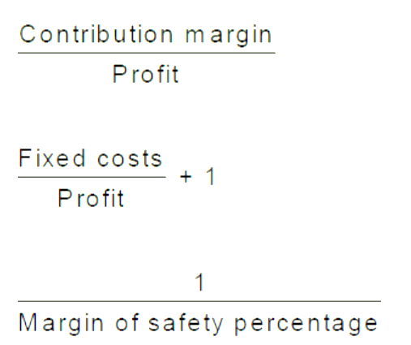
Business Risk Assessment
Degree of Operating Leverage - continued
Degree of Operating Leverage can be calculated in three ways:
1
2
3

Slide 40
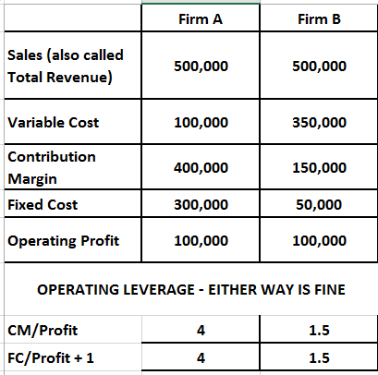
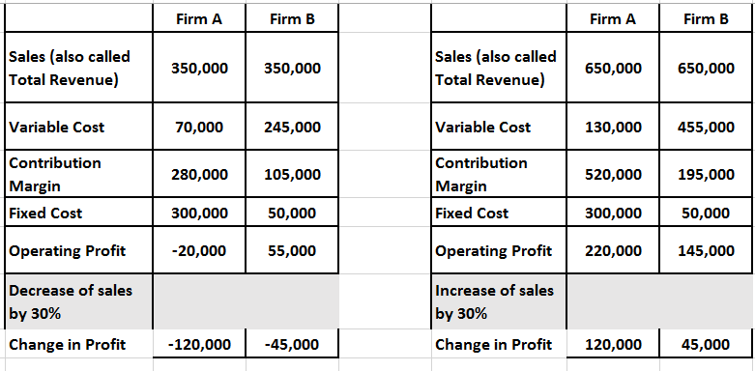
Business Risk Assessment
Degree of Operating Leverage - continued
Example: Degree of Operating Leverage

Slide 41
Business Risk Assessment
3. Degree of Operating Leverage - continued
Example: Degree of Operating Leverage

Slide 42
Business Risk Assessment
3. Degree of Operating Leverage - continued
Example: Degree of Operating Leverage
“the higher the risk, the higher the potential profit,”
And
“the higher the risk, the higher the potential loss.”
Firm A - Higher DOL leads to higher profit when sales increase and when sales decline tend to feel the negative impact more than companies with low operating leverage.

Slide 43
Business Risk Assessment
3. Degree of Operating Leverage - continued
High DOL
implies that a relatively small change in sales will result in large change in the Earnings before interest and tax (EBIT) and operating profit mean the same thing
DOL magnifies the variability of EBIT (operating profits) and, hence, business risk.
Magnifies increase and decrease!

Slide 44
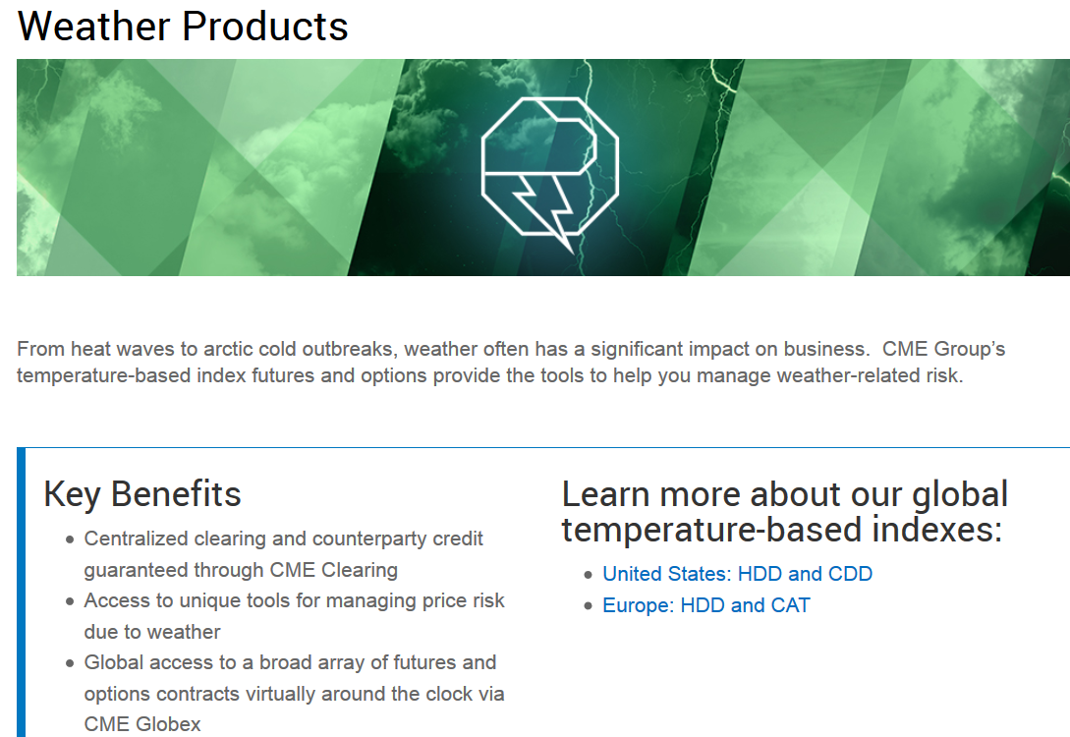
Business Risk Strategy Example
Temperature Based Indexes http://www.cmegroup.com/trading/weather/

Slide 45
Business Risk Strategy Example
Temperature Based Indexes http://www.cmegroup.com/trading/weather/
The contract pays out the difference between the degree days that you entered the contract and the degree days when you exit (sell) the contract. If the average temperature is 65 and a forecast is released that calls for a hotter than normal summer, then the price of entering the contract will jump because the expected payout is larger. An air conditioning firm can hedge by shorting this market (i.e., agree to sell at the enter price and buy at the exit price). This is because if the summer turns out to be cooler than normal then the short contracts will payout and this payout will offset some of the loss in profits from the slower sales of air conditioning units.

Slide 46
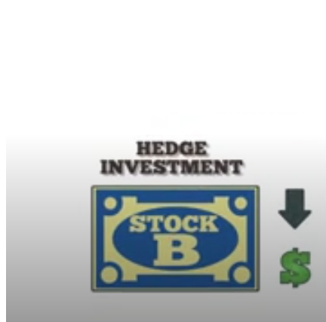
Business Risk Strategy Example
Hedging: A hedge is an investment to reduce the risk of adverse price movements in an asset. Normally, a hedge consists of taking an offsetting position in a related security, such as a futures contract.
https://www.investopedia.com/terms/h/hedge.asp

Slide 48
Questions re: Business Risk
Generally use EBIT (earnings before interest and taxes) Why?
Why do businesses take on business risk?
How do businesses get rid of business risk?
Who considers this business risk? What type of external and internal agencies?
How is marketing involved?
How is it measured ?
How is business risk connected to financial risk?
Other Risk Mitigation Strategies?

Slide 49
Questions re: Breakeven Analysis
Where do you get these costs from??
What if they are inaccurate estimates? What should be done?
What is the role of fixed cost in the breakeven?
What if I want to make 10,000 profit and not 0 profit - how do you use the formulas or profit equation?
Can you use formulas TC/P or TC/Q instead of formulas? Why or why not?
If the breakeven values are different than your Q and P from your market research results what do you do?

Slide 50
Financial Risk Analysis

Slide 51
Financial Risk Overview
What is financial risk?
Risk that results from the use of debt and thus having fixed debt obligations
Acquired by choice ( mostly!) and eliminated by?
Financial risk will increase owners ‘risk over and above the firm’s basic business risk
The use of debt concentrates the firm’s business risk on its owners. This concentration occurs because debtholders who receive fixed interest payments bear none of the business risk.
How is financial risk assessed?
Rations
Debt/Equity : higher number higher risk
Return on Asset
Return on Equity

Slide 52
Financial Risk Overview
Financial leverage – comes with financial risk and fixed debt obligations
Financial leverage has two major (but related) definitions.
1. Financial leverage refers to the amount of debt used to finance capital assets.
If a firm is "highly leveraged," it means they finance using debt and generally have more debt than equity.

Slide 53
Financial Risk Overview
Financial leverage
Financial leverage has two major (but related) definitions.
2. Financial leverage as an investment strategy
Use borrowed money to purchase capital assets and increase the potential return of owners (ROE)

Slide 54

Financial Risk Overview
Financial leverage
If a brewery consistently earns ROA of 21 % & has the opportunity to expand the business by buying assets and the bank interest rate would be 5 %
Should they take this opportunity?
What should they consider?

Slide 55
Financial Risk Overview
Why do businesses take on financial risk & financial leverage?
Because they need money! Consider business structures.
Means of increasing the return to owners (ROE) because returns are magnified through the use of financial leverage and debt
variations on ROE are magnified by use of financial leverage > 1
What is the downside of Financial Risk and Leverage?
Financial Risk & Leverage can magnify loss
Referred to as double edged sword concept or risk return tradeoff
Debt is both good and bad!

Slide 56
Financial Risk Assessment
What is an Appropriate Amount of Financial Risk & Leverage?
Firms must
Review expected future cash flows/ net income accrual basis: greater and more stable the expected future cash flows, the greater the debt carrying capacity.
Sustained ROA & liquidity
Compare ROA to bank interest rate : greater margin between ROA and interest rate ( e.g., ROA = 13% and interest rate offered by bank = 5%), the greater the ability to carry debt and support the higher risk
Consider a rule to apply to a firm to review how much financial risk & leverage to take on.

Slide 57
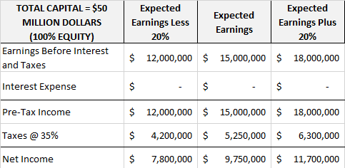
Financial Risk Assessment: Example 1
BEFORE TAX EFFECTS – USING PRE TAX INCOME
Return on Asset | 24% | 30% | 36%
Return on Equity | 24% | 30% | 36%

Slide 58
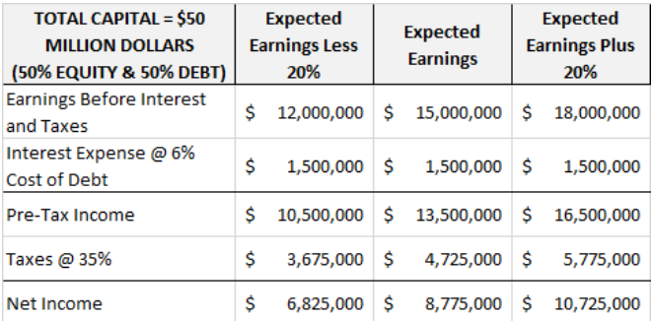
Financial Risk Assessment: Example 1
BEFORE TAX EFFECTS – USING PRE TAX INCOME
Return on Asset | 21% | 27% | 33%
Return on Equity | 42% | 54% | 66%

Slide 59
Financial Risk Assessment:
Financial leverage can be used to make the performance of a company look dramatically better than what can be achieved by solely relying on the use of equity financing.
Advantage: magnify the return-on-equity using debt
Potential Disadvantage:
increased financial risk – more financial obligations
magnify losses in downturn

Slide 60
Financial Risk
How do businesses get rid of financial risk?
Who considers this financial risk?
Is debt good or bad? Any rule on this?

Slide 61
Comparing Business Risk & Financial Risk

Slide 62
Comparing Business Risk & Financial Risk
Basis for Comparison | Business Risk | Financial Risk
Definition?
How to Assess this type of Risk?
Connected with?
How to Eliminate?
What is being leveraged?
Risk & Return Trade off ?

Slide 63
Risk & Return

Slide 64
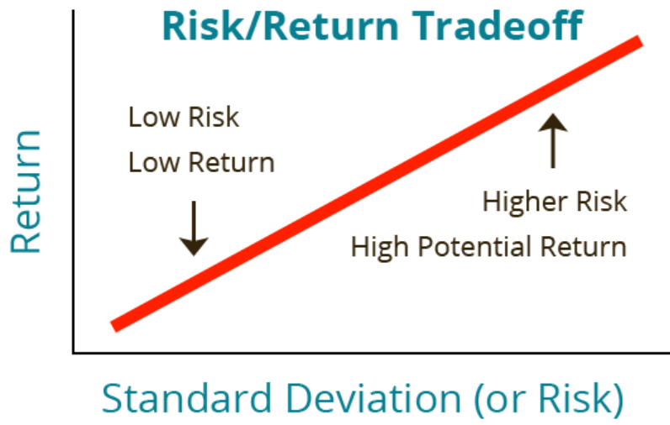
Risk & Return
What re the Risks and Return Trades in
Business Risk
Financial Risk

Slide 65
Questions
What is the Risk & Return Trade off ? Business ? Financial? Return?
Would you sooner face business or financial risk?
How is debt different from equity?
What advice would you give an entrepreneur who was trying to finance a start-up
Difference of financial risk and business risk? How are each assessed? Mitigated? Use by businesses?
Is debt good or bad? Any rule on this?
Explain the effect of leverage on expected ROE and risk

Slide 66
Questions
What businesses should be highly leveraged? not highly leveraged?
How does business structure come into play in capitalization?
What business structures/types and sector gets lots of bank loans ? Why?
What business structures/types and sector gets lots of equity? Why?
Can you define a decision rule for a business re: leverage usage?
What are the pros and cons of debt and equity financing re: leverage?
How is equity and financial risk linked?

Slide 67
Questions
What are the pros and cons of debt and equity financing?
What are the sources of capital for a small to medium business?
Is net income considered a source of financing?
How is debt and risk linked?
What are the ways to evaluate risk ?

Slide 68
End of Slides

Slide 69
examples

Slide 70
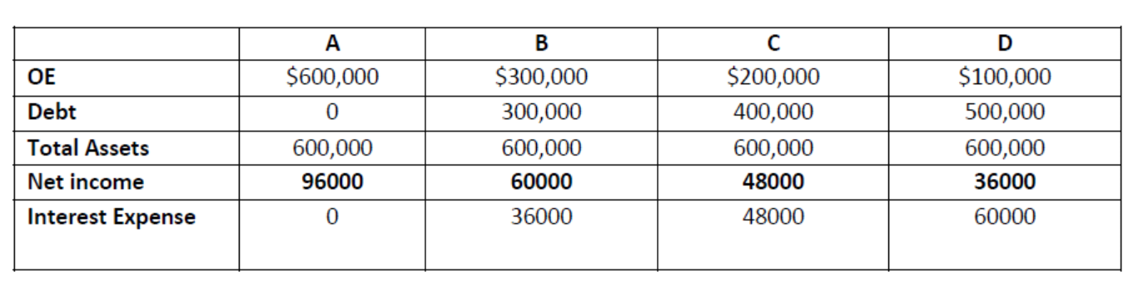
Financial Risk Assessment: Example 2
Scenario A
Earnings before interest = 96000 for all firms
Calculate the return on assets, return on equity, Debt/Equity and Interest Rate for all four businesses. Explain the answers.
Comment on the use and effect of leverage in this cases. What is being leveraged?

Slide 71
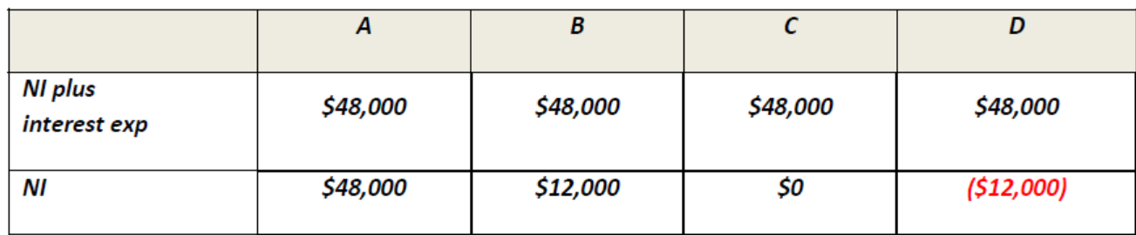
Financial Risk Assessment: Example 2
Scenario B
Earnings before interest = 48000 for all firms – same Debt and Equity levels
Calculate the return on assets, return on equity, Debt/Equity and Interest Rate for all four businesses. Explain the answers.
Comment on the use and effect of leverage in this cases. What is being leveraged?

Slide 72
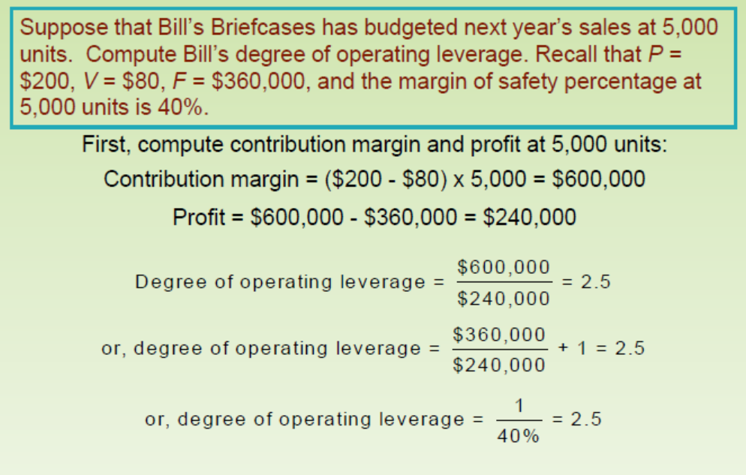
Business Risk Assessment
Example: Degree of Operating Leverage

Slide 73
Business Risk Assessment
Example: Degree of Operating Leverage
Interpreting the degree of operating leverage was 2.5 and profits were $240,000.
If expected sales were to increase to 6,000 units, a 20% increase, then profits would increase by 2.5 x 20%, or 50%, to $360,000.
$240,000 x 1.5 = $360,000
If expected sales were to decrease to 4,500 units, a 10% decrease, then profits would decrease by 2.5 x 10%, or 25%, to $180,000
$240,000 x 0.75 = $180,000

Slide 74
Breakeven and more than one product
If you produce more than one product ..then how do you calculate BE values?
Use the same formula but use a weighted average of contribution margins
Define the following:
Sales mix : proportion in which two or more products are sold
Ex: 80% product A and 20% product B
Contribution margin per product
Ex: product A $5 and product B $4
Weighted average contribution margin: sales mix times contribution margin for each product
Ex: Product A - 80% X $5 for product A and Product B – 20% X $4 for a weighted average contribution margin for all products of $ 4 + $0.8 = $4.80

Slide 75
Breakeven and more than one product
Product | A | B | C
Sales Price per Unit | $15 | $21 | $36
Variable Cost per Unit | $9 | $14 | $19
Sales Mix Percentage | 20% | 20% | 60%
Total Fixed Cost | $40,000

Slide 76
Example: Step 1: Calculate the contribution margin per unit for each product:
Product | A | B | C
Sales Price per Unit | $15 | $21 | $36
− Variable Cost per Unit | $9 | $14 | $19
Contribution Margin per Unit | $6 | $7 | $17

Slide 77
Example: Step 2: Calculate the weighted-average contribution margin per unit for the sales mix
Product | A | B | C
Contribution Margin per Unit | $6 | $7 | $17
× Sales Mix Percentage | 20% | 20% | 60%
 | $1.2 | $1.4 | $10.2
Sum: Weighted Average CM per Unit $12.80

Slide 78
Example: Step 3 Calculate total units of sales mix required to break-even
Total Fixed Cost | $40,000
÷ Weighted Average CM per Unit | $12.80
Break-even Point in Units of Sales Mix | 3,125
Break-even Point in Units of Sales Mix
= Total Fixed Cost ÷ Weighted Average CM per Unit

Slide 79
Example: Step 4: Calculate number units of product A, B and C
Product | A | B | C
Sales Mix Ratio | 20% | 20% | 60%
× Total Break-even Units | 3,125 | 3,125 | 3,125
Breakeven Q | 625 | 625 | 1,875

Slide 80
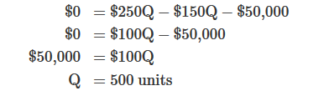
Measure Breakeven in Units: example
Company Info
Units sells for $250. Unit variable costs total $150, and total monthly fixed costs are $50,000. To find the break-even point in units for Company, set the profit to zero in profit equation or use the B/E Units formula
Profit Equation
BE Unit Formula
= 50000/ 250-150
= 500 units

Slide 81
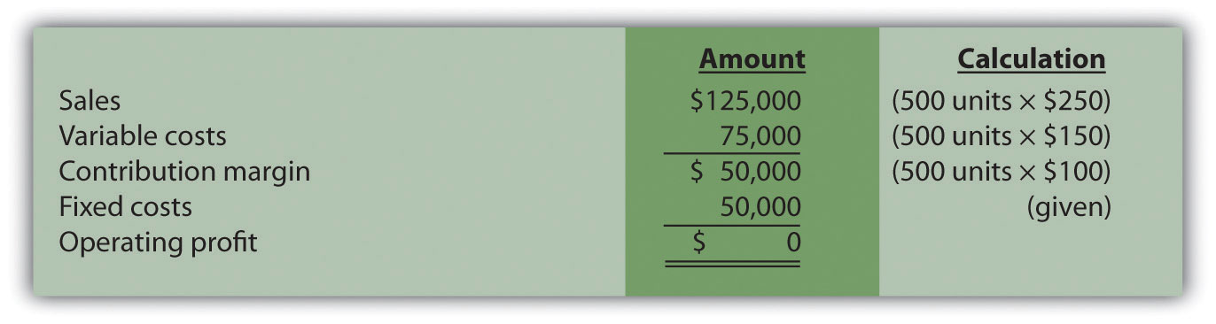
Measure Breakeven in Units: example
Company Info
Units sells for $250. Unit variable costs total $150, and total monthly fixed costs are $50,000. To find the break-even point in units for Company, set the profit to zero in profit equation or use the B/E Units formula

Slide 82
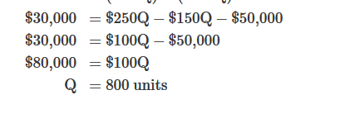
Measure Breakeven in Units: example
Company Info with target profit of 30,000
Units sells for $250. Unit variable costs total $150, and total monthly fixed costs are $50,000. To find the break-even point in units for Company, set the profit to zero in profit equation or use the B/E Units formula
Profit Equation

Slide 83
Measure Breakeven in Sales
How do companies find the break-even point if they cannot easily measure sales in units?
Compute Contribution Margin Ratio
Compute BE point in sales
1. Contribution Margin Ratio (often called contribution margin percent)
measures the amount each sales dollar contributes to (1) covering fixed costs and (2) increasing profit.
Computed as
contribution margin per unit (P-VC)
selling price per unit (P)
Can also compute as total contribution margin and total sales; the result is the same.

Slide 84
Measure Breakeven in Sales
2. Break even point in sales dollars =
Total fixed costs + Target profit
Contribution margin ratio

Slide 85
Measure Breakeven in Sales: Example
Same Company Info:
Contribution margin ratio (CMR)
=($250−$150)÷$250
Thus each dollar in sales contributes 40 cents ($0.40) to covering fixed costs and increasing profit.
BE point is sales
= {50,000 + 0}/.40
= 125,000 sales
Company must achieve $125,000 in total sales to break even.

Slide 86
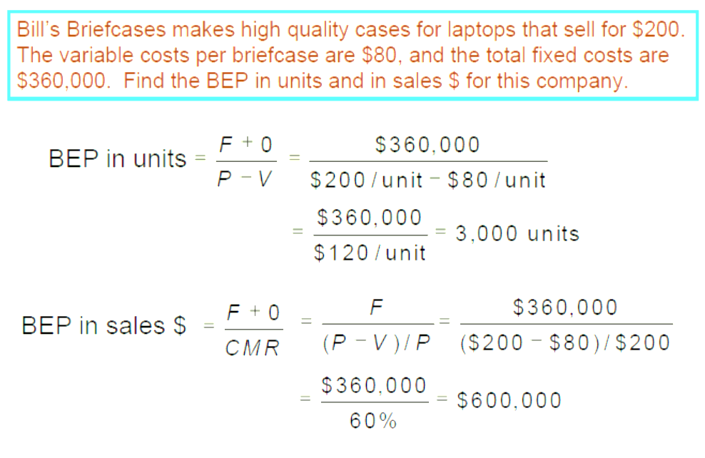
Example: CMR, Units and Sales

Slide 87
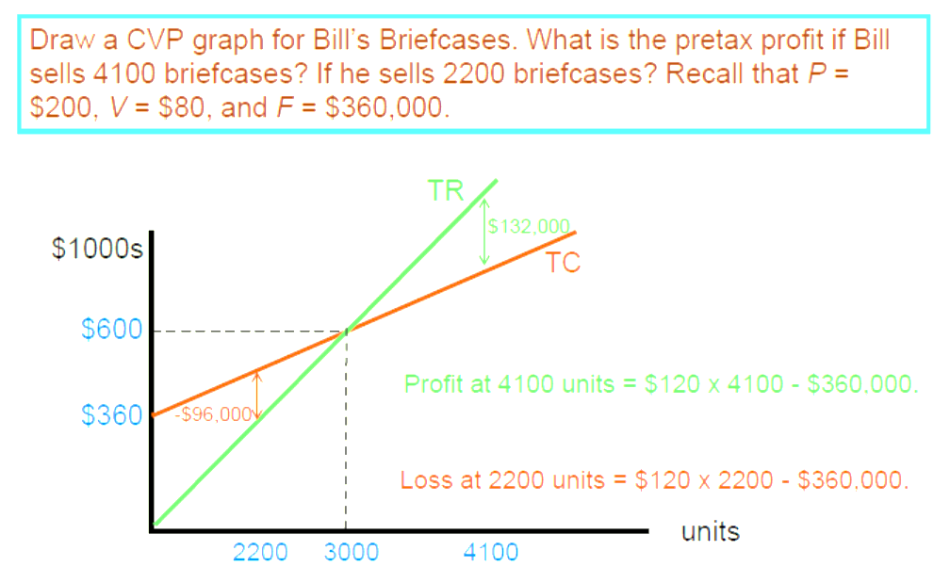
Example: CMR, Units and Sales

Slide 88
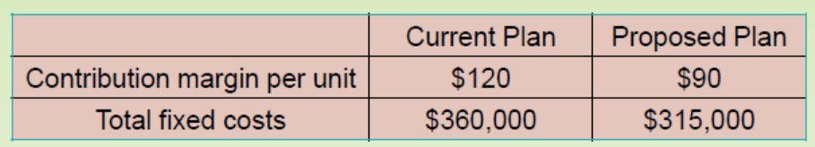
Measuring Breakeven and Indifference Point
What if you want to compare two alternatives ?
Use indifference point – Pt in units is the Q for which the profit equations of the two alternatives are equal.
Profit (current plan) = $120Q - $360,000
Profit (proposed plan) = $90Q - $315,000
Set equal to each other:
$120Q - $360,000 = $90Q - $315,000
$30Q = $45,000
Q = 1,500 units
Notes:
(Because selling price is the same under both of these alternatives, profits will be the same when total costs are the same.) At unit volumes below the indifference point, the alternative with the lower fixed cost gives higher profits; at volumes above the indifference point, the alternative with the higher fixed cost is more profitable.
Managers may have no correct answer in their choice of cost structure. Analytical tools such as the indifference point, margin of safety, and CVP graph help them evaluate alternatives, but the decision depends on their attitudes about risk and return. If they want to avoid risk, they will choose production A, forgoing the potential for higher profits from production B. If they are venturesome, they probably will be willing to take some risk for the potentially higher returns and choose production B.
Cost indifference point is useful in many decision situations, such as quality improvement programmes, different marketing plans, production plans or methods etc.
Cost indifference point should be distinguished from break-even point. Break-even point com­pares total sales and total cost of a product. Also, at break-even point total cost line intersects total sales line. As stated above, cost indifference signifies equality of total costs of two alternatives. At cost indifference point, total cost lines of two alternatives intersect each other.

Slide 89
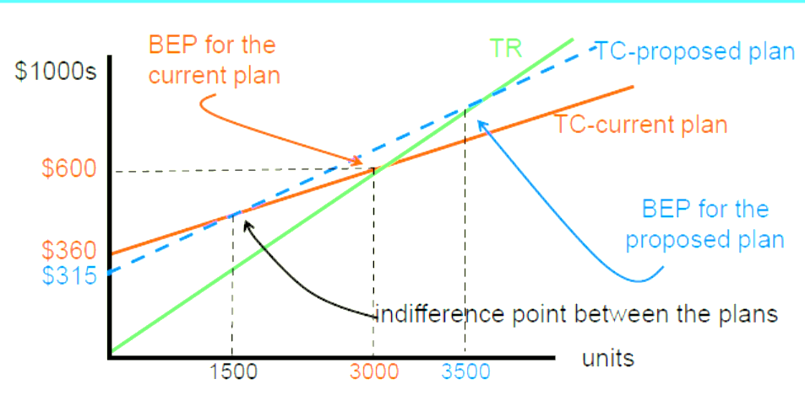
Measuring Breakeven and Indifference Point
What if you want to compare two alternatives ? Graph it
Total Revenue Curve is same for both alternatives
Cost curves are different

Slide 90
Measuring Breakeven and Indifference Point
What if you want to compare two alternatives
The current plan breaks even before the proposed plan.
At 1500 units, the plans have the same total cost.
Less than 1500, profits are negative under BOTH plans at this point.
Greater than 1500 ( but really 3000) , current plan better
Each unit sold provides a larger contribution to profits under the current plan.
Notes:
(Because selling price is the same under both of these alternatives, profits will be the same when total costs are the same.) At unit volumes below the indifference point, the alternative with the lower fixed cost gives higher profits; at volumes above the indifference point, the alternative with the higher fixed cost is more profitable.

Slide 91
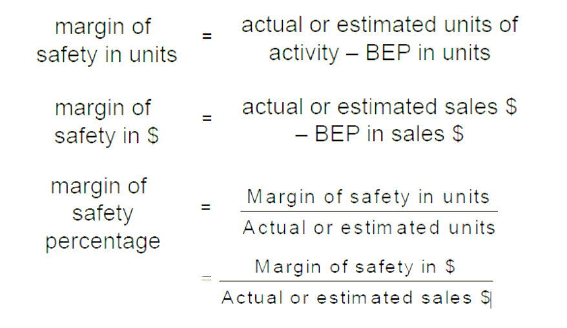
Measuring Breakeven and Margin of Safety
The margin of safety is a measure of how far past the breakeven point a company is operating, or plans to operate. It can be measured 3 ways.
1
2
3

Slide 92
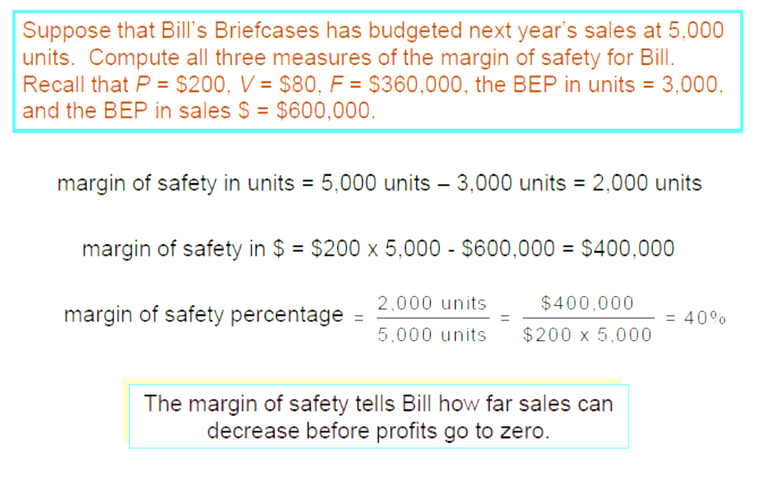
Example: Measuring Breakeven and Margin of Safety

